Slide 1
ZeroTrustAI – AI-Powered Adaptive Identity and Access Management with Behavioral Risk Analytics
Submitted by:
K.Navya-240030180
K.Bhavya-2420030181
Greeshma Sai-2420030550
Hasini Peddi-2420030784
Group Number: 10 Section: 7 cluster: 3
Under the Guidance of
Dr. j. kavitha reddy

Slide 2
Abstract
ZeroTrustAI is an AI-based security system that protects users and important resources from unauthorized access. It follows the Zero Trust approach, which means the system does not automatically trust anyone. It checks the user, device, login activity, location, and other details to find any unusual or suspicious activity.
The system uses AI and machine learning to calculate the risk of each access request. Depending on the risk, it can allow the user, ask for extra verification, restrict access, or block the user. An admin dashboard shows the risk scores, suspicious activities, and access records. Overall, ZeroTrustAI helps to make user access more secure and adaptive.

Slide 3
Problem Statement
Traditional security systems mainly depend on passwords and fixed access rules to protect users and resources.
They may not be able to:
Detect unusual user behaviour.
Identify suspicious login activities.
Continuously check users and devices after login.
Change access based on the current risk level.
Therefore, there is a need for a security system that can continuously monitor user activity, identify suspicious behaviour, calculate the risk, and take the appropriate access decision.

Slide 4
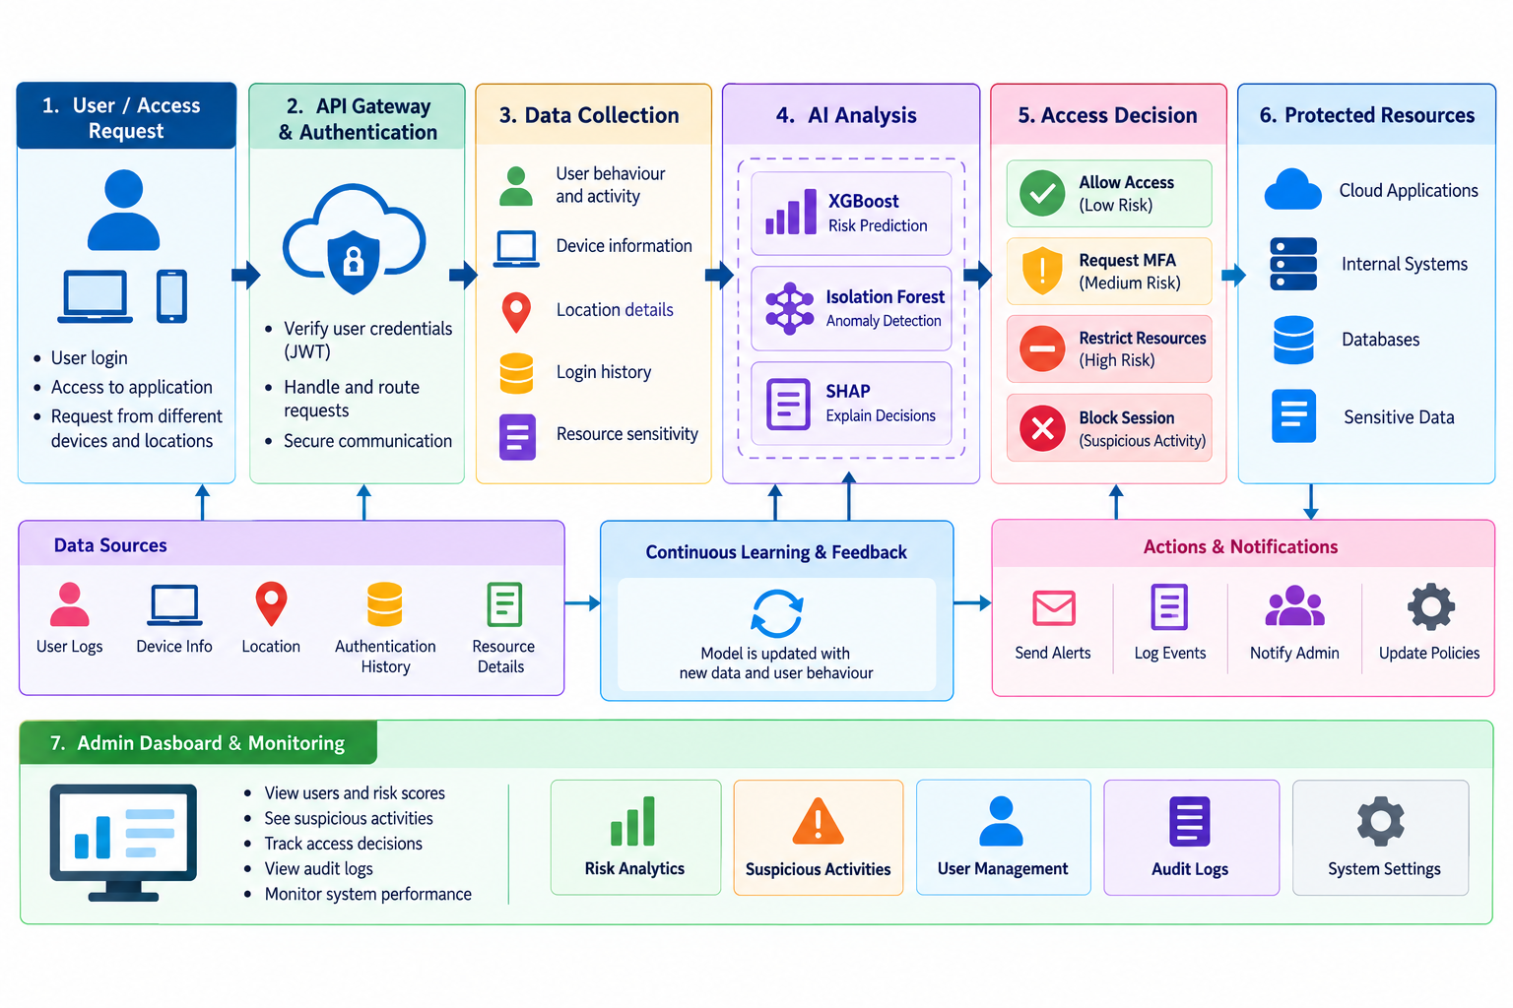
APPROACH

Slide 5
Objectives
The main objectives of this project are:
To build a secure access system based on the Zero Trust approach.
To continuously check users, devices, and access requests.
To identify unusual or suspicious user activities.
To calculate a risk score for each access request.
To take suitable action based on the risk, such as allowing, restricting, or blocking access.
To provide an admin dashboard for monitoring users, risks, suspicious activities, and access records.
To use AI and machine learning to make access decisions more adaptive and secure.

Slide 6
Feasibility
Technical Feasibility
Operational Feasibility
Economic Feasibility
React.js for frontend
FastAPI and Python for backend
PostgreSQL for database
Scikit-learn and XGBoost for ML
SHAP for explainability
JWT for authentication
Docker for deployment
Simple admin dashboard
Automated risk analysis
Minimal manual intervention
Easy monitoring of security events
Uses widely available development tools
Open-source technologies can be used
No special hardware is required10:30 AM

Slide 7
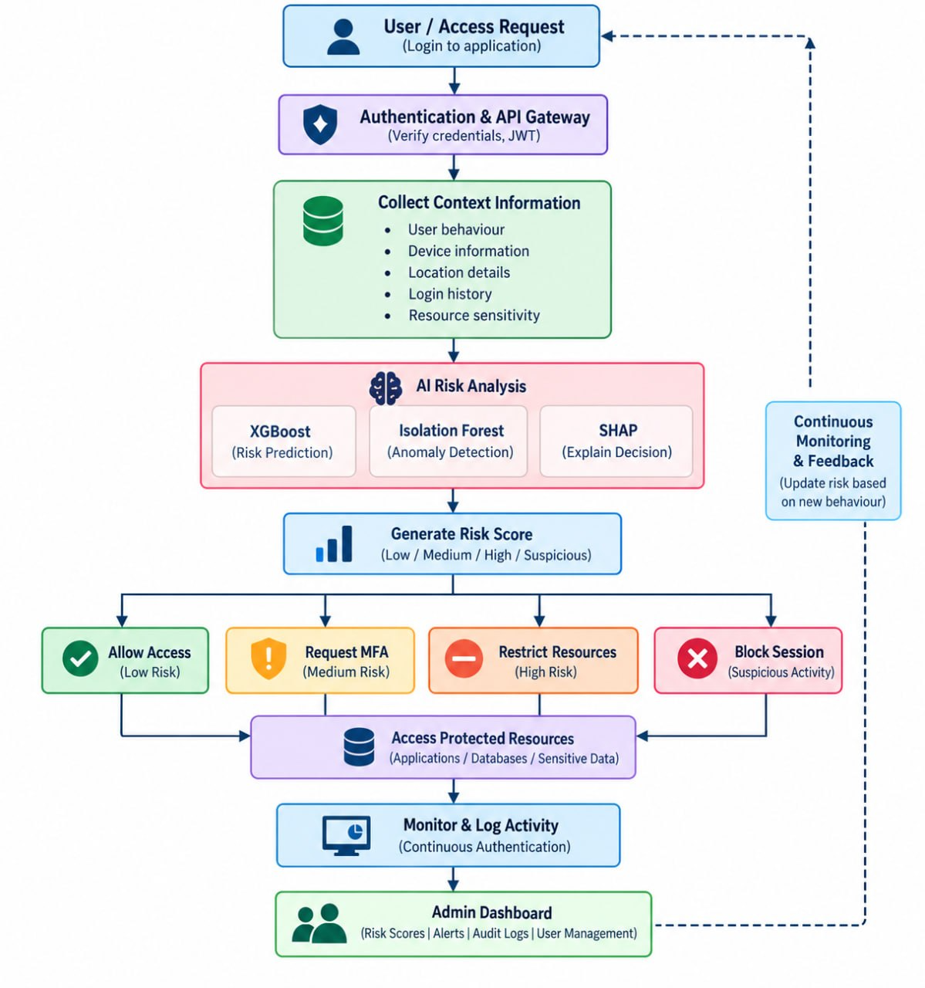
System Design

Slide 8
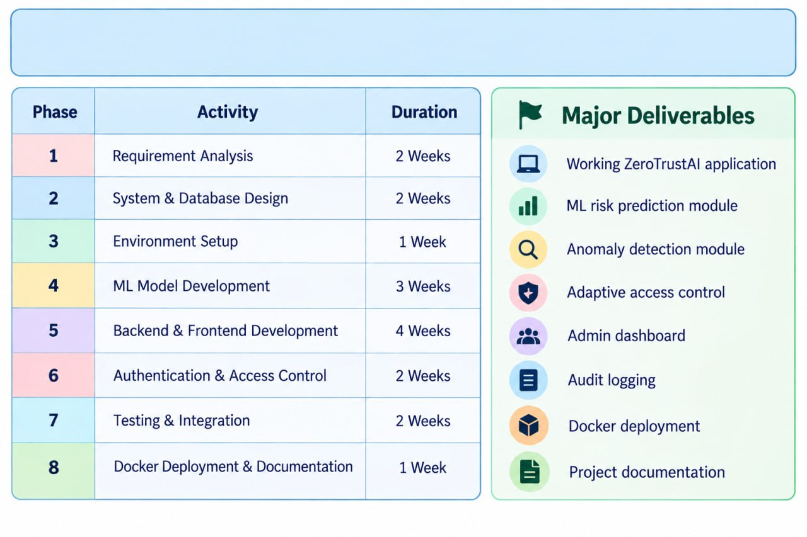
Project plan

Slide 9
Methodology
3. AI Risk Analysis
Use:
XGBoost → Risk prediction
Isolation Forest → Anomaly detection
SHAP → Explain security decisions
4. Risk Score Generation
Calculate the current risk level of the access request.
5. Adaptive Access Decision
🟢 Low Risk → Allow
🟡 Medium Risk → Request MFA
🟠 High Risk → Restrict
🔴 Suspicious → Block
6. Continuous Monitoring
Continue monitoring user activity even after login.
7. Admin Monitoring
Display risk scores, suspicious activities, access decisions and audit logs on the dashboard.
This follows the continuous verification and adaptive decision approach described in your abstract
User Authentication
Verify the user's credentials and
create a secure session using JWT.
2. Context Collection
Collect important information
such as:
User behaviour
Device information
Location
Login history
Resource sensitivity

Slide 10
MODERN TOOLS & TECHNOLOGIES
React.js
User interface & dashboard
Backend
FastAPI
REST API & business logic
Programming
Python
AI/ML processing
Database
PostgreSQL
Store users, logs & risk data
ML
Scikit-learn
Machine learning support
Risk Prediction
XGBoost
Predict access risk
Anomaly Detection
Isolation Forest
Detect unusual behaviour
Explainable AI
SHAP
Explain model decisions
Authentication
JWT
Secure user authentication
Deployment
Docker
Containerized deployment

